Slide 1
Cultural Awareness, Safety, Sensitivity, Competence and Humility in Research
HQP Caucus Workshop: Autumn, 2024
Dr. Umme Kulsum¹ Memorial University of Newfoundland, Grenfell Campus
Sheridan Thompson² Memorial University of Newfoundland, St. John’s Campus

Slide 2
Workshop Outline
Definitions of Culture
Concepts: cultural values, safety, awareness, sensitivity, competence, humility
Practices that enable a healthy environment including cultural awareness…etc.
Reflection Pieces- anonymous
Additional resources
Notes:
- The reflection pieces are short written pieces completed in about 5-8 mins. They will help you to related comprehensively to the material, and will connect participants through experience.
-The reflection pieces are anonymous. You do not have to submit them to us, but if you do we may share your story anonymously.

Slide 3
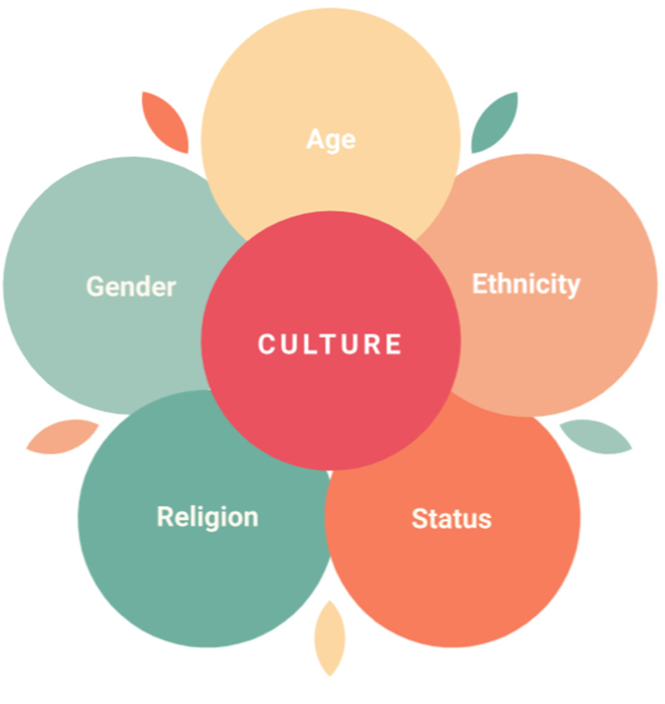
Culture
- Culture has many definitions that include values, beliefs, expressed through identity, language, religion, and practices shared by community
- Culture influences—but doesn’t determine—our behaviour and our understanding of other people’s behaviour
- It’s also important to consider culture beyond an individual level and reflect on how it exists within groups, organizations and societies
- The culture of an environment shapes and influences everyone involved
Language
Source: Modified from the original source, https://www.culturallyconnected.ca/
Notes:
Sheridan shares an approach in her own research…

Slide 4
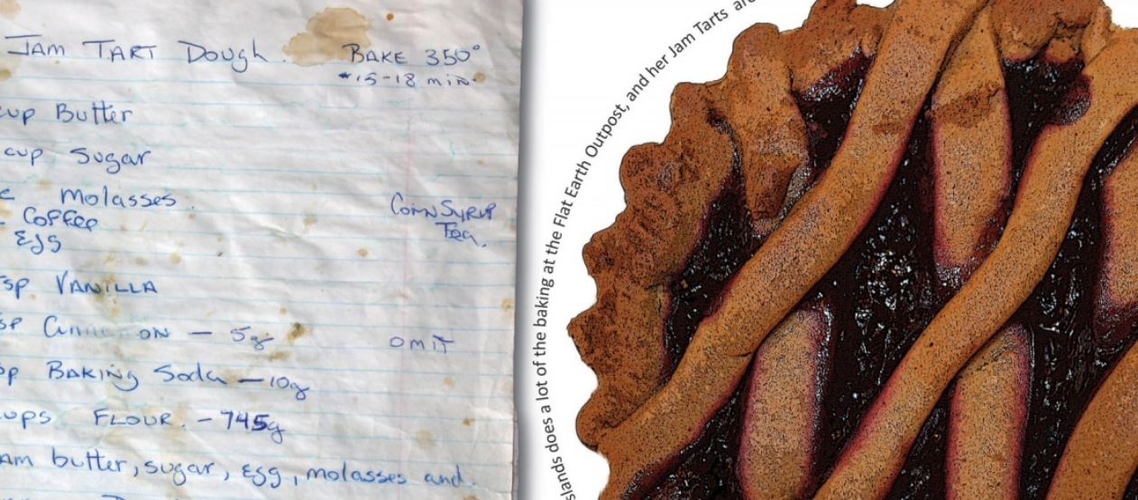
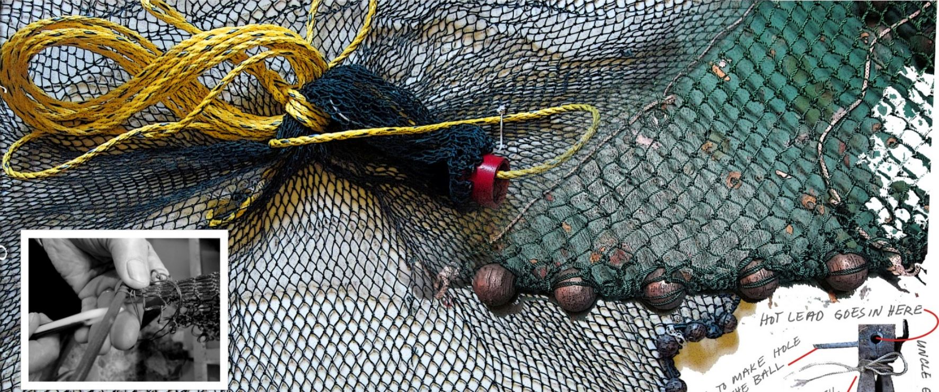
Cultural Values
- Cultural values are the core principles or ideals that an entire community or
society share and is the foundation to their culture
Cultural values can be expressed in tangible ways, such as art, literature, and/or food, or in less visible aspects like social norms, ethical standards, and religious beliefs
Example. Newfoundland Cultural Values
Towards and Encyclopedia of Local Knowledge. By Pam Hall and Community Collaborators
Notes:
Pam Hall is an IWP4 Collaborator

Slide 5
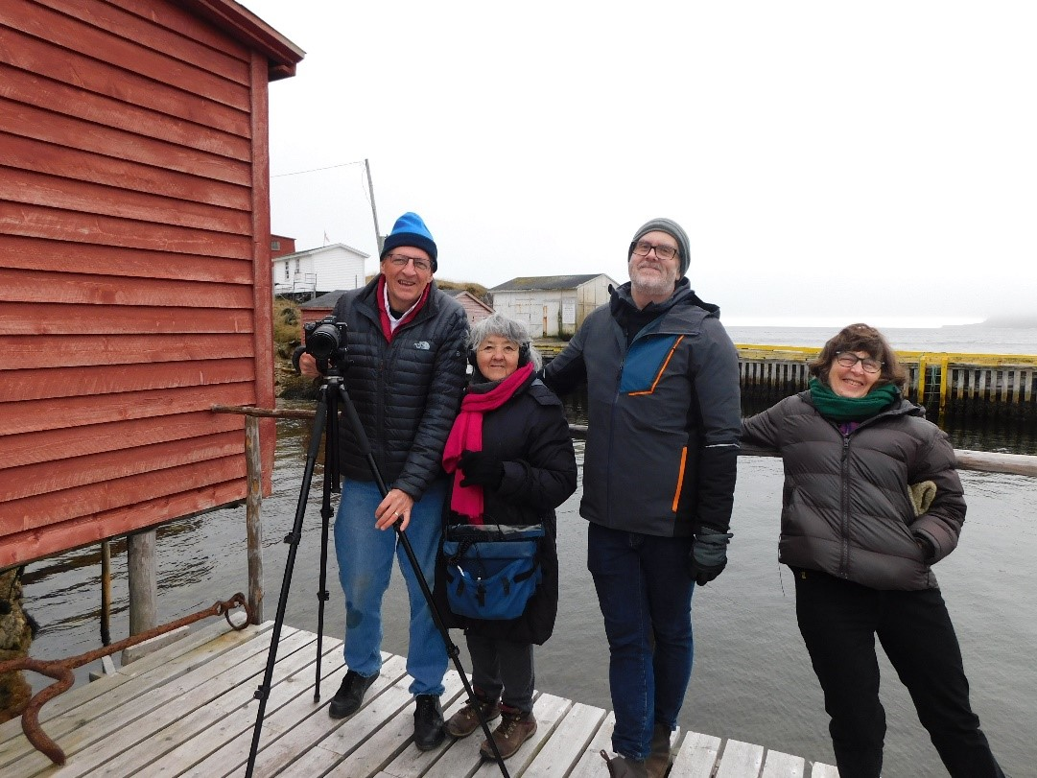
Diversity of Cultural Values in Research…
When working in a cross-cultural settings, its important to be able to see a
situation from more than one perspective
Cultural differences are just that; different, not better or worse but just another way of seeing the world.
Suspend judgement. Neutralize your position. Be curious. Acknowledge all perspectives.
Example.
Newfoundland Cultural Values embraced in FOCI Research
Taking on Water

Slide 6
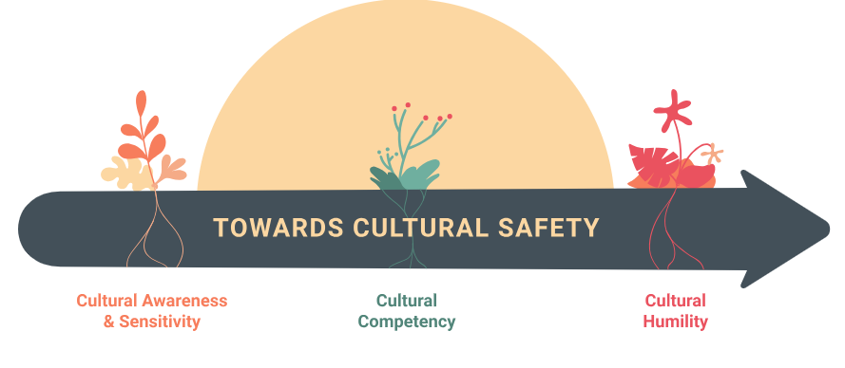
Source: https://www.culturallyconnected.ca/

Slide 7
Cultural Safety
- Culturally unsafe practices involve any actions that diminish, demean or disempower the cultural identity and well-being of an individual.
- Creating a culturally safe practice involves working to create safe space that is sensitive and responsive to the respondents/community social, political, linguistic, economic and spiritual realities
Source: https://www.culturallyconnected.ca/
Notes:
Ultimately, adopting a cultural humility perspective is one of the most effective ways to enable cultural safety

Slide 8
Cultural Awareness
- Recognizing that differences and similarities exist between cultures.
- As for example: learning about the histories that impact Indigenous Peoples in Canada is an important part of developing cultural awareness.
Source: https://www.indigenoushealthnh.ca/cultural-safety#cultural-humility#cultural-awareness
Notes:
The journey of cultural humility often starts with cultural awareness

Slide 9
Cultural Sensitivity
- Cultural sensitivity grows when we start to see the influences of our own culture and acknowledge that we have biases.
- This can be an eye-opening experience, and it may take courage and humility to walk this path.
- Cultural sensitivity is NOT about treating everyone the same.
- With cultural awareness and sensitivity comes a responsibility to act respectfully.
Source: https://www.indigenoushealthnh.ca/cultural-safety#cultural-humility#cultural-awareness

Slide 10
Cultural Competence
- We can increase our cultural competence by developing knowledge, skills and attitudes for working effectively and respectfully with diverse people.
- It’s about reducing the number of assumptions we make about people based on our biases.
- Cultural competency does not require us to become experts in cultures different from our own.
Source: https://www.indigenoushealthnh.ca/cultural-safety#cultural-humility#cultural-awareness

Slide 11
A Cultural Humility Perspective
- Requires a commitment to lifelong learning, exercising self-reflection and critique, being comfortable with not knowing, and recognizing the dynamics of power and privilege
- Being open to learning about the values, beliefs and experiences in order to develop mutual understanding, successful partnership and cultural safety
Source: https://www.culturallyconnected.ca/

Slide 12
Resources – Decolonizing Research
Indigenous Cultural Awareness Training through OFI (Deadline Oct. 31 2024)
https://www.ofi.ca/impact/indigenous-engagement/cultural-awareness-training
To learn more about Memorial University's Strategic Framework for Indigenization please visit the Office of Indigenous Affairs.
https://www.mun.ca/indigenous/
Canada’s National Centre for Truth and Reconciliation
https://nctr.ca/

Slide 13
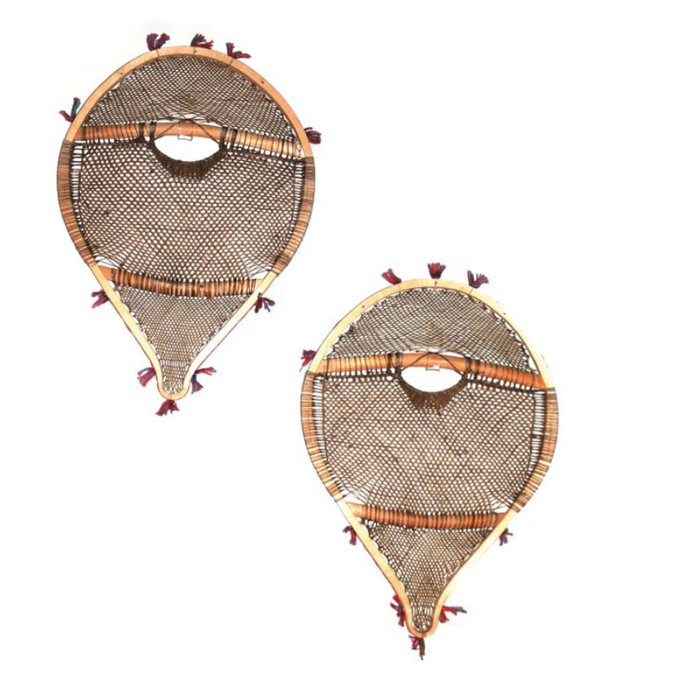
Additional Resources
Cultural Humility CITL MUN
https://www.youtube.com/watch?v=wEtmhUDMpug
Culturally Connected
https://www.culturallyconnected.ca/
Equity, Diversity, Inclusion and Anti-Racism, Memorial University
https://www.mun.ca/edi-ar/
INNU SNOWSHOES taken from https://www.mun.ca/indigenous/media/production/memorial/administrative/indigenous/media-library/indigenous-affairs/reports/Print_Indigenization_Framework.pdf
Ashamat, Innu snowshoes made of wood and rawhide in Northwest River, Labrador, 1979.
Image courtesy of The Rooms, St. John’s, NL.

